Slide 1
Welcome to 4th Grade
“The First Huddle”

Slide 2
Meet the Fourth Grade Team
Brick & Mortar teacher
Digital Academy teacher
Digital Academy teacher
"In learning you will teach, and in teaching you will learn!"--Phil Collins
"I have the simplest taste. I'm always satisfied with the best!" -- Oscar Wilde
"Work hard, have fun, make history."-- Jeff Bezos

Slide 3
Fourth Grade Welcome Message
The Fourth Grade team would like to extend a warm, Pineview welcome to our students and parents! We are excited for the 2020 -2021 school year. During these unprecedented times, we will practice all measures to ensure the health and safety to our precious students and teachers.

Slide 4
Daily Schedule Brick & Mortar
8:15 – 8:55 Special Area
8:55 – 9:05 Morning News/Harmony
9:05 – 9:40 iReady
M-W-F Writing T/TH Sci/SS
9:40 – 11:10 ELA
11:10 – 12:40 Math
12:40 – 1:05 Lunch
1:05 – 2:05 Writing
M-W-F Writing T/TH Sci/SS
2:05 – 2:25 DEAR
2:25 – 2:40 Developmental Play
2:40 – 2:45 Preparing for Dismissal
2:45 Students are dismissed

Slide 5
First Day Procedures
Morning
Afternoon
Go directly to your class
Eat breakfast in classroom
Find out how each student goes home.
Students will be dismissed to the way their parent has designated them to go.
This way will not be altered, unless there is a written note from the parent, a parent called the school, or a parent has communicated with the teacher.

Slide 6
Need to Know
Access to Pineview’s campus will be limited to students and staff members only.
When students arrive on campus, they will have their temperature checked. If a student’s temperature is 100 degrees or higher, they will go directly to the clinic and will have to be picked up.
Students can bring a water bottle to school; no water fountain usage
No playground access; students will have indoor movement in their classroom.

Slide 7
Need to Know
When students are transitioning to special area or walking through the hallway, they will wear a mask and practice social distancing.
During class, students may remove their masks during whole group instruction or independent work(where social distancing is possible). However, while moving around the classroom and during small group with their peers or teacher, students must wear their mask.
While in the cafeteria, students will wear their mask while waiting for their food and get hand sanitizer before picking up their food. Students will remove their mask while eating.

Slide 8
Safety First

Slide 9
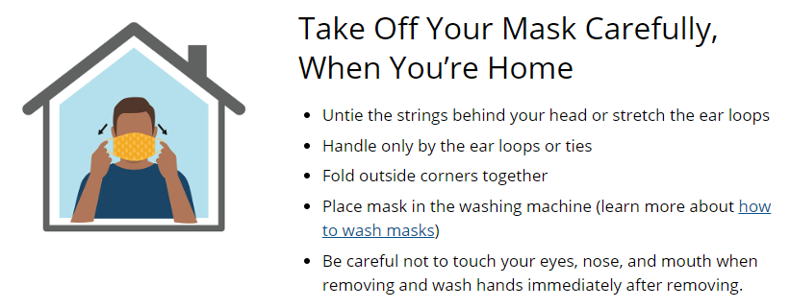
Safety First

Slide 10
Safety First

Slide 11
Communication
Teacher’s Contact Information
Ways to Communication
Tashara Daniel danielt@leonschools.net
Karlisa Johnson johnsonk6@leonschools.net
Dr. Ida Walker walkeri@leonschools.net
By phone 488 - 2819
Remind - messaging
Canvas (DA) – built in learning platform
Zoom – virtual (DA)

Slide 12
Digital Academy

Slide 13
First Day Procedures Digital Academy
Morning
Etiquette
Log onto Canvas promptly at 8:30 am.
Be prepared to:
Meet your classmates
Attend the Virtual Orientation on Canvas via Zoom. Once logged into Canvas, select HR Recess and click the Zoom link on the left.

Slide 14
Daily Schedule Digital Academy “Live“ Instruction
*Monday, Tuesday, Thursday and Friday
8:30 – 9:30 ELA Group A
9:40 – 10:40 ELA Group B
10:50 – 11:50 ELA Group C
11:50 – 12:30 Teacher Lunch/Planning
12:30 - 1:30 Math Group A
1:40 – 2:40 Math Group B
2:40 – 2:50 Read Aloud
*Wednesday – small group, writing, Science and Social Studies
*Student breakfast and lunch distribution will be 10:30 – 11:00.

Slide 15
Digital Academy Virtual Student Orientation
When: August 31
Time: 8:30 am
Where: Canvas via Zoom
Once logged into Canvas, select HR recess & click the zoom link on the left.
Be present. Be on time.
Canvas Parent Academy is a parent tutorial that demonstrates how to navigate the Canvas learning platform. See Leon County Schools Website

Slide 16
4th Grade Supply List Digital Academy
Students will be provided a backpack filled with school supplies, including earbuds for students usage with their device.
Four weeks of curriculum will be distributed that will correspond with online instruction. (hard copy)
A desktop, webcam and computer equipment.

Slide 17
Coach Expectations (teacher)
Take daily attendance
Provide daily “live” virtual instruction for language arts, math, and science
Provide individualized instruction in small groups and in one-on-one sessions tailored to meet students’ individual needs
Monitor the quality and completion of independent work of each student
Provide individualized feedback based on students’ weekly progress
Communicate with students and families using a variety of methods (Remind, Teams, email, etc.) to keep everyone updated of weekly goals and expectations

Slide 18
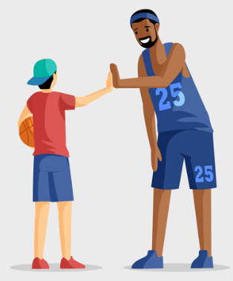
Assistant Coach Expectations (parents)
It is recommended that parents partner with the teacher as a guide (assistant coach) this is an average commitment of 3-4 hours per day. Parents can support by assisting in the ways listed below:
Ensure student’s daily attendance
Monitor students daily
Monitor daily and weekly progress
Assist students in navigating online instruction

Slide 19
Player Expectation (student)
Players or students are expected to attend daily “live” virtual lessons and be present and engaged throughout the entire lesson. Also, it is the expectation that all daily assignments are completed by the end of the school day (2:50 P.M.). This is an average commitment of 6 hours per day.
Be present and on-time for daily instruction
Be present and engaged throughout the entire “live” virtual instruction
Complete daily independent assignments by 2:50 P.M

Slide 20
Grading Expectations Digital Academy
Student grades will be a result of daily participation, completion of assigned tasks, and weekly assessments. When students are tardy, or not present for daily “live” instruction their grades for that subject will be impacted significantly. All assigned tasks must be completed and submitted by the end of each day in order to receive a daily grade for ELA, math, science, and social studies.
Daily participation grades will be given for both “live” instruction sessions (ELA & math). Therefore, it is very important that students be on time and present each day.
A daily work grades will be given to students for complete assigned tasks.

Slide 21
Hats off to a super year! #Changing the game
Thank you for visiting our virtual orientation. We look forward to a great school year. Please reach out to us with any questions. In the spirit of compassion, flexibility and grace.
The 4th Grade Team!

